Slide 1
Modelling with graphs
Graphical representations

Slide 2
How our teaching resources are designed for the classroom

Slide 3
I can model real-life situations graphically.

Slide 4
The rate of change is how quickly one variable changes in relation to another.
The gradient is a measure of how steep a line is, calculated by finding the rate of change in the y-direction with respect to the positive x-direction.

Slide 5

Modelling with graphs
Reading distance time graphs
Drawing distance time graphs

Slide 6
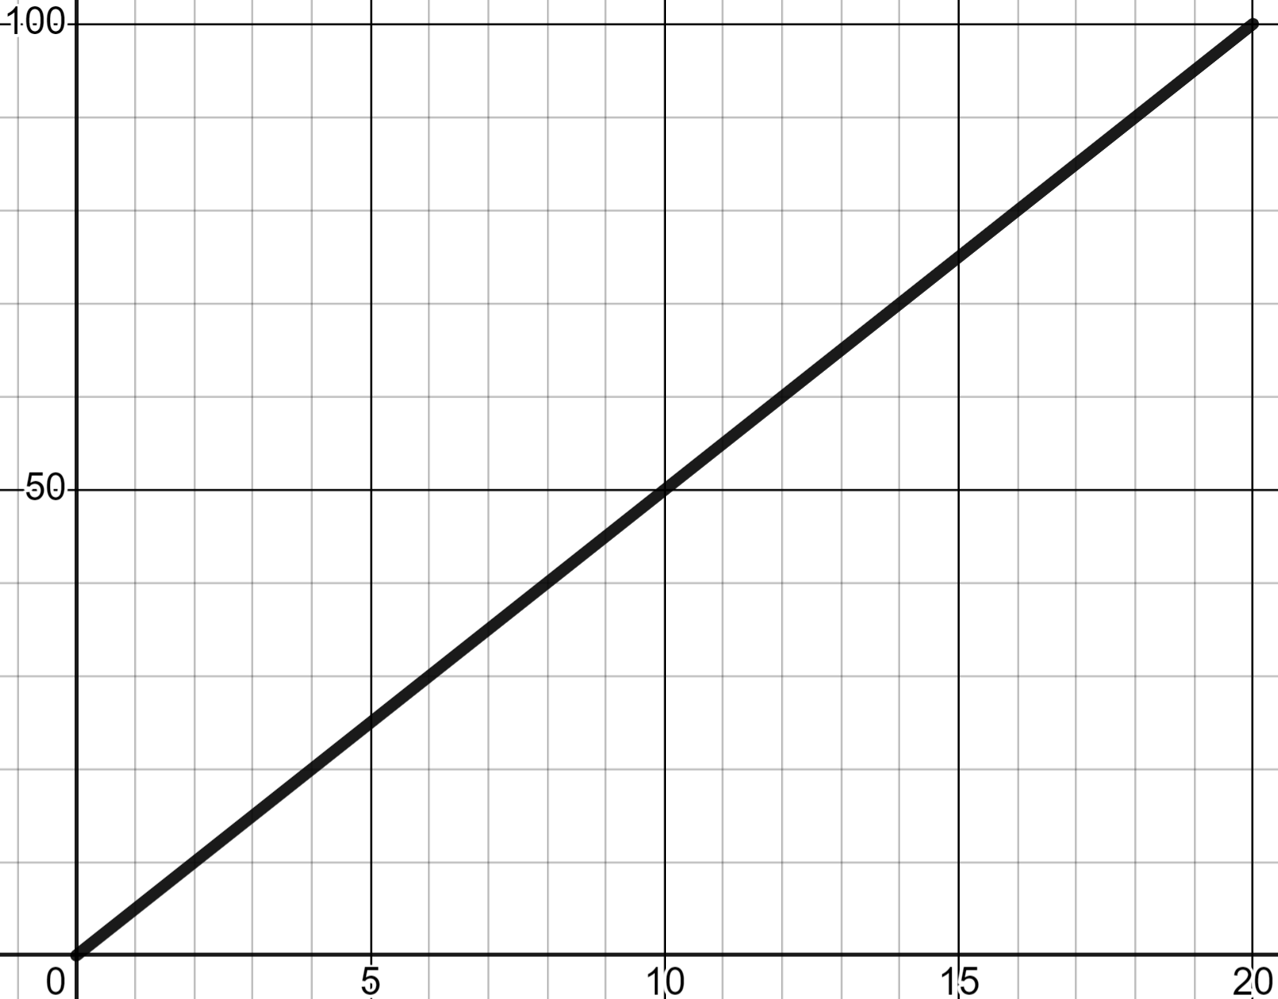
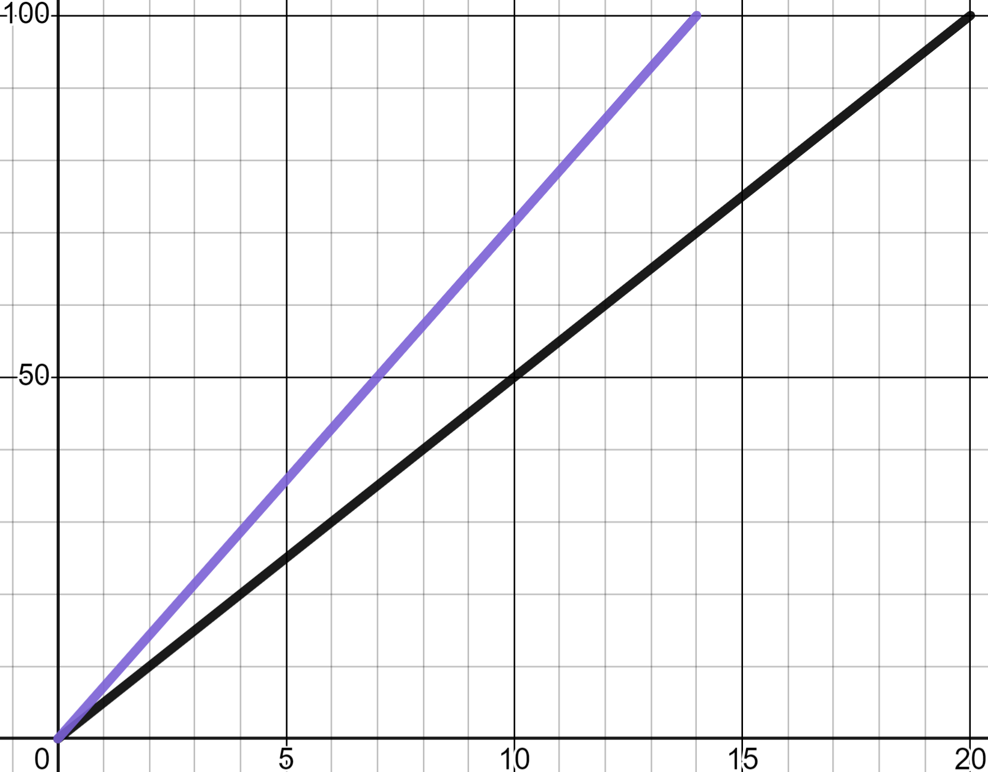


Reading distance time graphs
Distance time graphs can model many real-life situations and they tell us many useful things.
Sofia has been recording her data from PE lessons and plots this graph.
distance (m)
That’s what I did a few years ago.
That’s what I did a few years ago. This is what I can do now.
time (s)

Slide 7
Reading distance time graphs
What can you read from this distance time graph?
distance (m)
That’s what I did a few years ago.
That’s what I did a few years ago. This is what I can do now.
time (s)

Slide 8
Reading distance time graphs
What can you read from this distance time graph?
Sofia ran 100 m on both occasions.
(14, 100)
(20, 100)
✖
✖
Sofia’s time has changed.
Sofia’s time has changed. 20 s down to 14 s
distance (m)
time (s)

Slide 9
Reading distance time graphs
What can you read from this distance time graph?
Sofia ran 100 m on both occasions.
(14, 100)
(20, 100)
✖
✖
Sofia’s time has changed.
Sofia’s time has changed. 20 s down to 14 s
distance (m)
Both lines have a consistent gradient reflecting a constant rate of change/constant speed.
time (s)

Slide 10
Reading distance time graphs
What can you read from this distance time graph?
Sofia ran 100 m on both occasions.
✖
(14, 100)
Sofia’s time has changed.
Sofia’s time has changed. 20 s down to 14 s
distance (m)
✖
(14, 70)
Both lines have a consistent gradient/speed.
The steeper gradient reflects a greater speed.
time (s)

Slide 11
Reading distance time graphs
What can you read from this distance time graph?
Sofia ran 100 m on both occasions.
✖
(14, 100)
Sofia’s time has changed.
Sofia’s time has changed. 20 s down to 14 s
distance (m)
✖
(14, 70)
Both lines have a consistent gradient/speed.
70 m
The steeper gradient reflects a greater speed.
14 s
time (s)

Slide 12
Reading distance time graphs
What can you read from this distance time graph?
Sofia ran 100 m on both occasions.
✖
(14, 100)
Sofia’s time has changed.
Sofia’s time has changed. 20 s down to 14 s
distance (m)
faster
100 m
Both lines have a consistent gradient/speed.
The steeper gradient reflects a greater speed.
14 s
time (s)

Slide 13
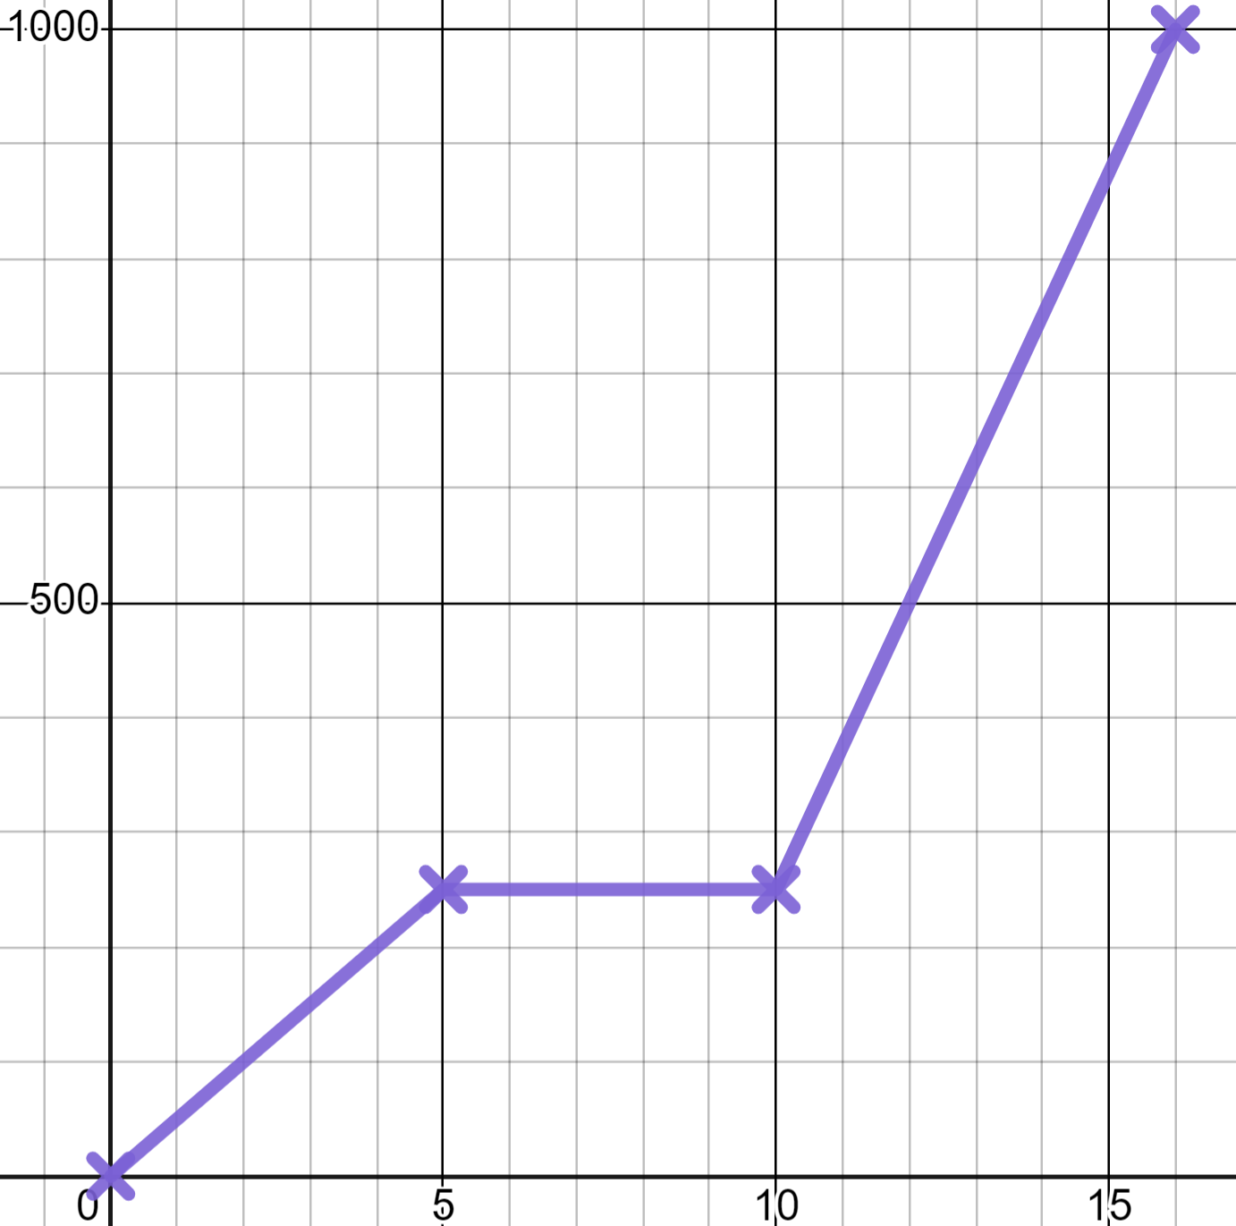
Reading distance time graphs
Sofia’s smart-watch tracks her walk to school.
1000
This moment looks unusual on the graph.
distance from home (m)
500
What do you think happened here?
time (mins)
0
5
10
15

Slide 14

Reading distance time graphs
Sofia’s smart-watch tracks her walk to school.
1000
This moment looks unusual on the graph.
Of course! A gradient of zero means I stopped.
distance from home (m)
500
No change in distance is a stop
That’s when you stopped to pick me up.
time (mins)
0
5
10
15

Slide 15
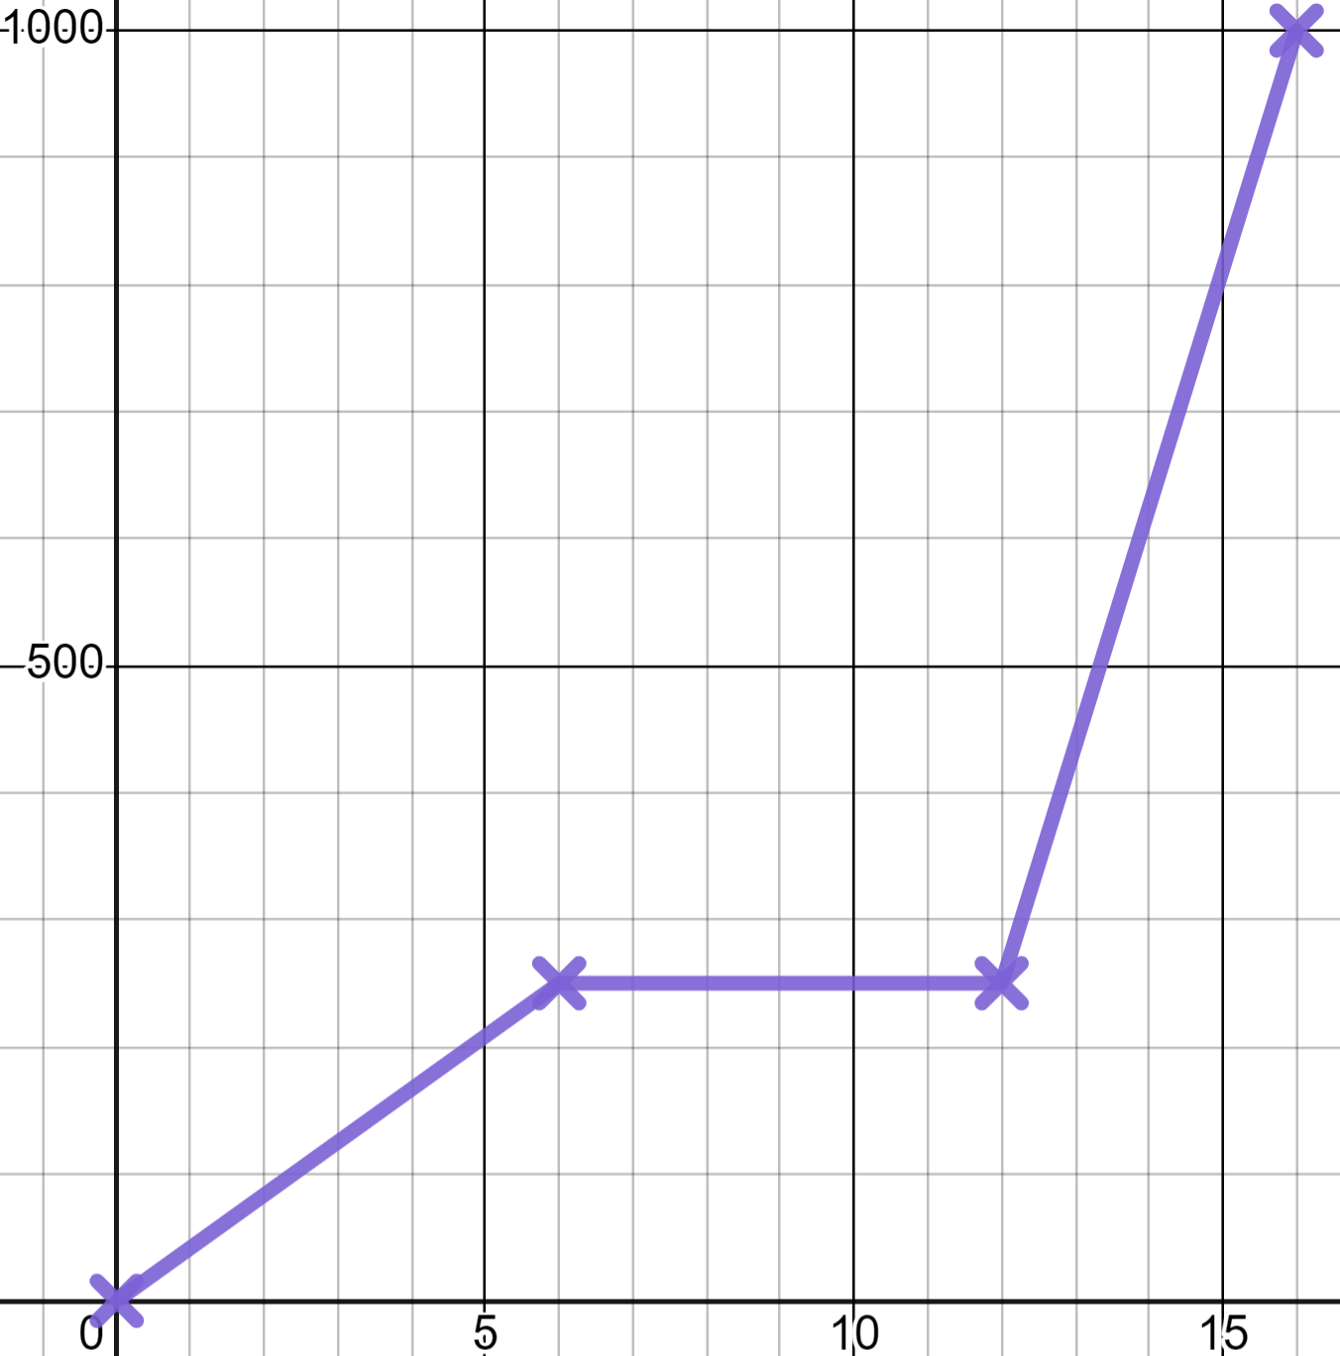

Reading distance time graphs
On this day how long does it take for Sofia to reach Izzy’s house?
1000
250 minutes
distance from home (m)
6 minutes
500
(6, 250)
✖
12 minutes
time (mins)
0
5
10
15

Slide 16
Reading distance time graphs
On this day how many minutes is Sofia waiting at Izzy’s house?
1000
0 minutes
distance from home (m)
6 minutes
500
(6, 250)
(12, 250)
✖
✖
12 minutes
time (mins)
0
5
10
15

Slide 17
Reading distance time graphs
What does this change in gradient tell us?
1000
Change of direction
distance from home (m)
The road got steeper
500
Change of speed
time (mins)
0
5
10
15

Slide 18
Reading distance time graphs
What does this change in gradient tell us?
1000
The steeper gradient shows a faster rate of change of distance with respect to time therefore a greater speed.
distance from home (m)
500
Change of speed
time (mins)
0
5
10
15

Slide 19
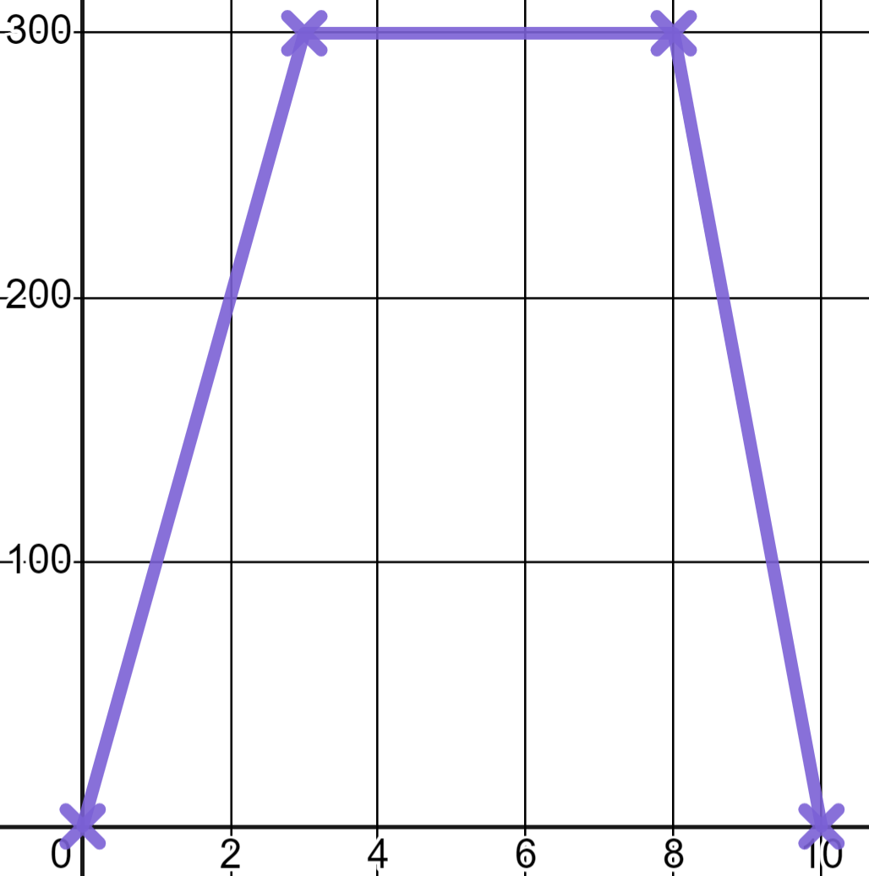
Reading distance time graphs
This graph represents Izzy’s journey to a friend’s house. How far did Izzy travel in total?
300
10 metres
200
300 metres
distance from home (m)
20 metres
100
600 metres
300 m out and 300 m back.
time (mins)
2
4
6
8
10

Slide 20
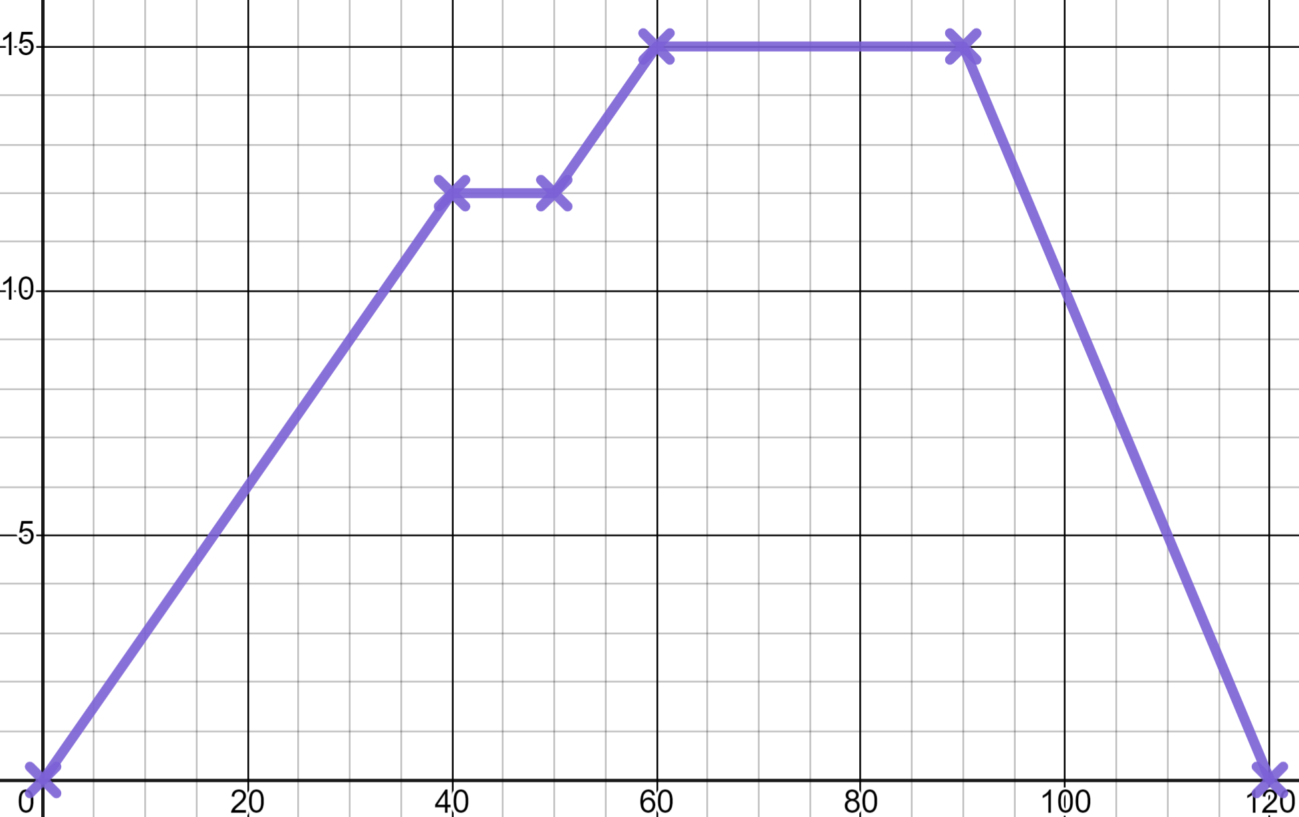
Reading distance time graphs
1) Here is a distance time graph of a cycle ride that Jacob took.
a) How far away was he at 30 minutes?
15
b) What happened on 40 minutes?
distance (km)
10
c) At what time did Jacob start to return home?
d) How far did Jacob cycle in total?
5
e) Was Jacob’s furthest point from home the high point, or low point, in altitude of this cycle?
20
40
60
80
100
120
time (mins)
Write a sentence to justify your answer.

Slide 21

Reading distance time graphs
2) Alex shows you a distance time graph which he drew before this lesson.
He now knows there are moments in it which can not be true.
For each labelled moment declare if that moment is possible or impossible and write a sentence explaining why.
d)
distance from home (m)
c)
e)
b)
a)
time (mins)

Slide 22
Reading distance time graphs
1) Here is a distance time graph of a cycle ride that Jacob took.
a) How far away was he at 30 minutes?
15
✖
(90, 15)
At 9 km
distance (km)
b) What happened on 40 minutes?
A 10 minute stop.
10
(30, 9)
✖
c) At what time did Jacob start to return home?
5
On 90 minutes.
d) How far did Jacob cycle in total?
30 km
15 km out and 15 km back.
20
40
60
80
100
120
time (mins)

Slide 23
Reading distance time graphs
1) Here is a distance time graph of a cycle ride that Jacob took.
The high point.
You might have written: “The gradient on the journey home is the steepest part of the graph which tells us it is the highest speed.”
15
distance (km)
10
5
e) Was Jacob’s furthest point from home the high point, or low point, in altitude of this cycle?
20
40
60
80
100
120
time (mins)
Write a sentence to justify your answer.

Slide 24
Reading distance time graphs
1) Here is a distance time graph of a cycle ride that Jacob took.
The high point.
You might have written: “Jacob has a break on the way there but, not on the way back. This would suggest the route back was easier (i.e. downhill)”
15
distance (km)
10
5
e) Was Jacob’s furthest point from home the high point, or low point, in altitude of this cycle?
20
40
60
80
100
120
time (mins)
Write a sentence to justify your answer.

Slide 25
Reading distance time graphs
1) Here is a distance time graph of a cycle ride that Jacob took.
You were not allowed to write:
“The return journey is going downhill on the graph”
15
distance (km)
10
5
e) Was Jacob’s furthest point from home the high point, or low point, in altitude of this cycle?
20
40
60
80
100
120
time (mins)
Write a sentence to justify your answer.

Slide 26
Reading distance time graphs
2) Alex shows you a distance time graph which he drew before this lesson. He now knows there are moments in it which can not be true.
For each labelled moment declare if that moment is possible or impossible and write a sentence explaining why.
You might have written:
a)
Possible - This a is stop in the journey.
d)
distance from home (m)
b) and e)
Impossible - This would be a change in position in zero time.
c)
e)
b)
c)
Possible - This is a move towards home at a constant speed.
a)
d)
Impossible - This would represent going back in time.
time (mins)

Slide 27
Modelling with graphs
Reading distance time graphs
Drawing distance time graphs

Slide 28
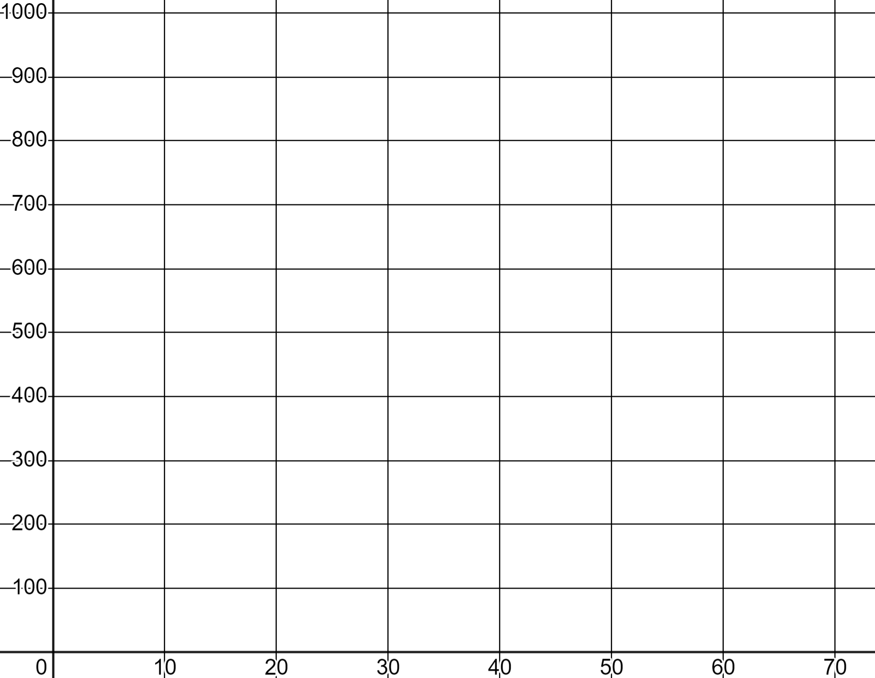

Drawing distance time graphs
Sometimes we already have the information and we have to draw the distance (d) time (t) graph. With a grid we can plot the points accurately.
d
✖
✖
I walk to the shops 1 km away, it takes 20 minutes. I am 20 minutes in the shop then I walk home at the same speed. Half way home I stop for 10 minutes to drop some items off with a relative. Then I walk home at the same speed I walked earlier.
✖
Same speed means same change in distance over the same change in time (same gradient).
t

Slide 29
Drawing distance time graphs
Sometimes we already have the information and we have to draw the distance (d) time (t) graph. With a grid we can plot the points accurately.
d
✖
✖
I walk to the shops 1 km away, it takes 20 minutes. I am 20 minutes in the shop then I walk home at the same speed. Half way home I stop for 10 minutes to drop some items off with a relative. Then I walk home at the same speed I walked earlier.
✖
✖
t
✖

Slide 30
Drawing distance time graphs
Sometimes we already have the information and we have to draw the distance (d) time (t) graph. With a grid we can plot the points accurately.
d
✖
✖
Our model makes the assumption that Aisha walked at a constant speed when she was moving, hence the straight lines. This is standard unless you are informed otherwise in a simple distance time graph model like this.
✖
✖
t
✖

Slide 31
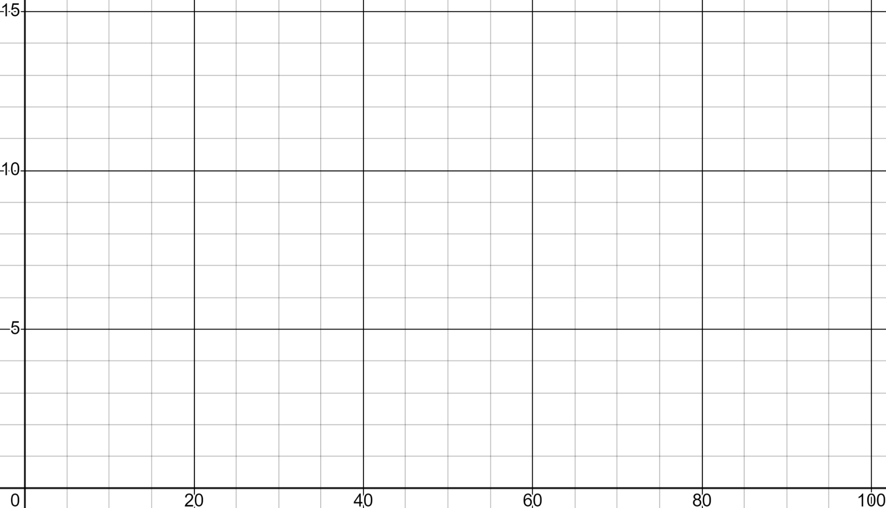

Drawing distance time graphs
What is the first coordinate that should be plotted for this journey?
We start fast and cycle 10 km in 20 minutes. We have to stop and rest for 15 minutes. We start cycling again and reach our destination, 15 km from home 15 minutes later. We hang out there for 25 minutes before cycling straight home in 25 minutes.
(20 mins, 10 km)
(20, 10)
d
15
(10, 10)
✖
10
✖
(10, 20)
5
t
20
40
60
80
100

Slide 32
Drawing distance time graphs
What is the next coordinate that should be plotted?
We start fast and cycle 10 km in 20 minutes. We have to stop and rest for 15 minutes. We start cycling again and reach our destination, 15 km from home 15 minutes later. We hang out there for 25 minutes before cycling straight home in 25 minutes.
(20, 25)
d
15
(35, 10)
(20, 10)
✖
No change in distance, 15 mins more time.
10
✖
✖
(35, 25)
5
t
20
40
60
80
100

Slide 33
Drawing distance time graphs
What is the next coordinate that should be plotted?
We start fast and cycle 10 km in 20 minutes. We have to stop and rest for 15 minutes. We start cycling again and reach our destination, 15 km from home 15 minutes later. We hang out there for 25 minutes before cycling straight home in 25 minutes.
(15, 15)
d
15
✖
(50, 25)
✖
10
✖
✖
(35, 10)
(50, 15)
5
15 mins more time reaching 15 km
t
20
40
60
80
100

Slide 34
Drawing distance time graphs
What is the next coordinate that should be plotted?
We start fast and cycle 10 km in 20 minutes. We have to stop and rest for 15 minutes. We start cycling again and reach our destination, 15 km from home 15 minutes later. We hang out there for 25 minutes before cycling straight home in 25 minutes.
(25, 15)
d
15
✖
✖
(75, 15)
(50, 15)
✖
25 mins more time, no change in distance.
10
✖
✖
(50, 40)
5
t
20
40
60
80
100

Slide 35
Drawing distance time graphs
What is the next coordinate that should be plotted?
We start fast and cycle 10 km in 20 minutes. We have to stop and rest for 15 minutes. We start cycling again and reach our destination, 15 km from home 15 minutes later. We hang out there for 25 minutes before cycling straight home in 25 minutes.
(100, 30)
d
15
✖
✖
(75, 40)
(75, 15)
✖
10
✖
✖
(100, 0)
5
25 mins more time reaching distance 0 km
t
20
40
60
80
100

Slide 36
Drawing distance time graphs
There are many moments in maths where a sketch of a model will suffice.
I walk to my friend’s house 400 m away. That takes 5 minutes. I wait 5 minutes when picking them up. Then we walk together to the cinema 600 m further away but we’re chatting so we walk a little slower, it takes us 10 minutes.
d
It’s useful to start by totalling the distance and time.
400 m + 600 m = 1000 m
5 + 10 + 5 = 20 minutes
t

Slide 37
Drawing distance time graphs
There are many moments in maths where a sketch of a model will suffice.
I walk to my friend’s house 400 m away. That takes 5 minutes. I wait 5 minutes when picking them up. Then we walk together to the cinema 600 m further away but we’re chatting so we walk a little slower, it takes us 10 minutes.
d
1000
✖
(20, 1000)
(5, 400)
✖
✖
(10, 400)
Our sketch is good enough to show this ‘slower’, less steep, gradient.
t
20

Slide 38
Drawing distance time graphs
Complete the distance time graph sketch for the journey.
I walk to my friend’s house 400 m away. That takes 3 minutes. I wait 1 minute when picking them up. Then we jog together to the sports centre 800 m which takes us 4 minutes.
d
1200
✖
(8, 1200)
(3, 400)
✖
✖
(4, 400)
t
8

Slide 39

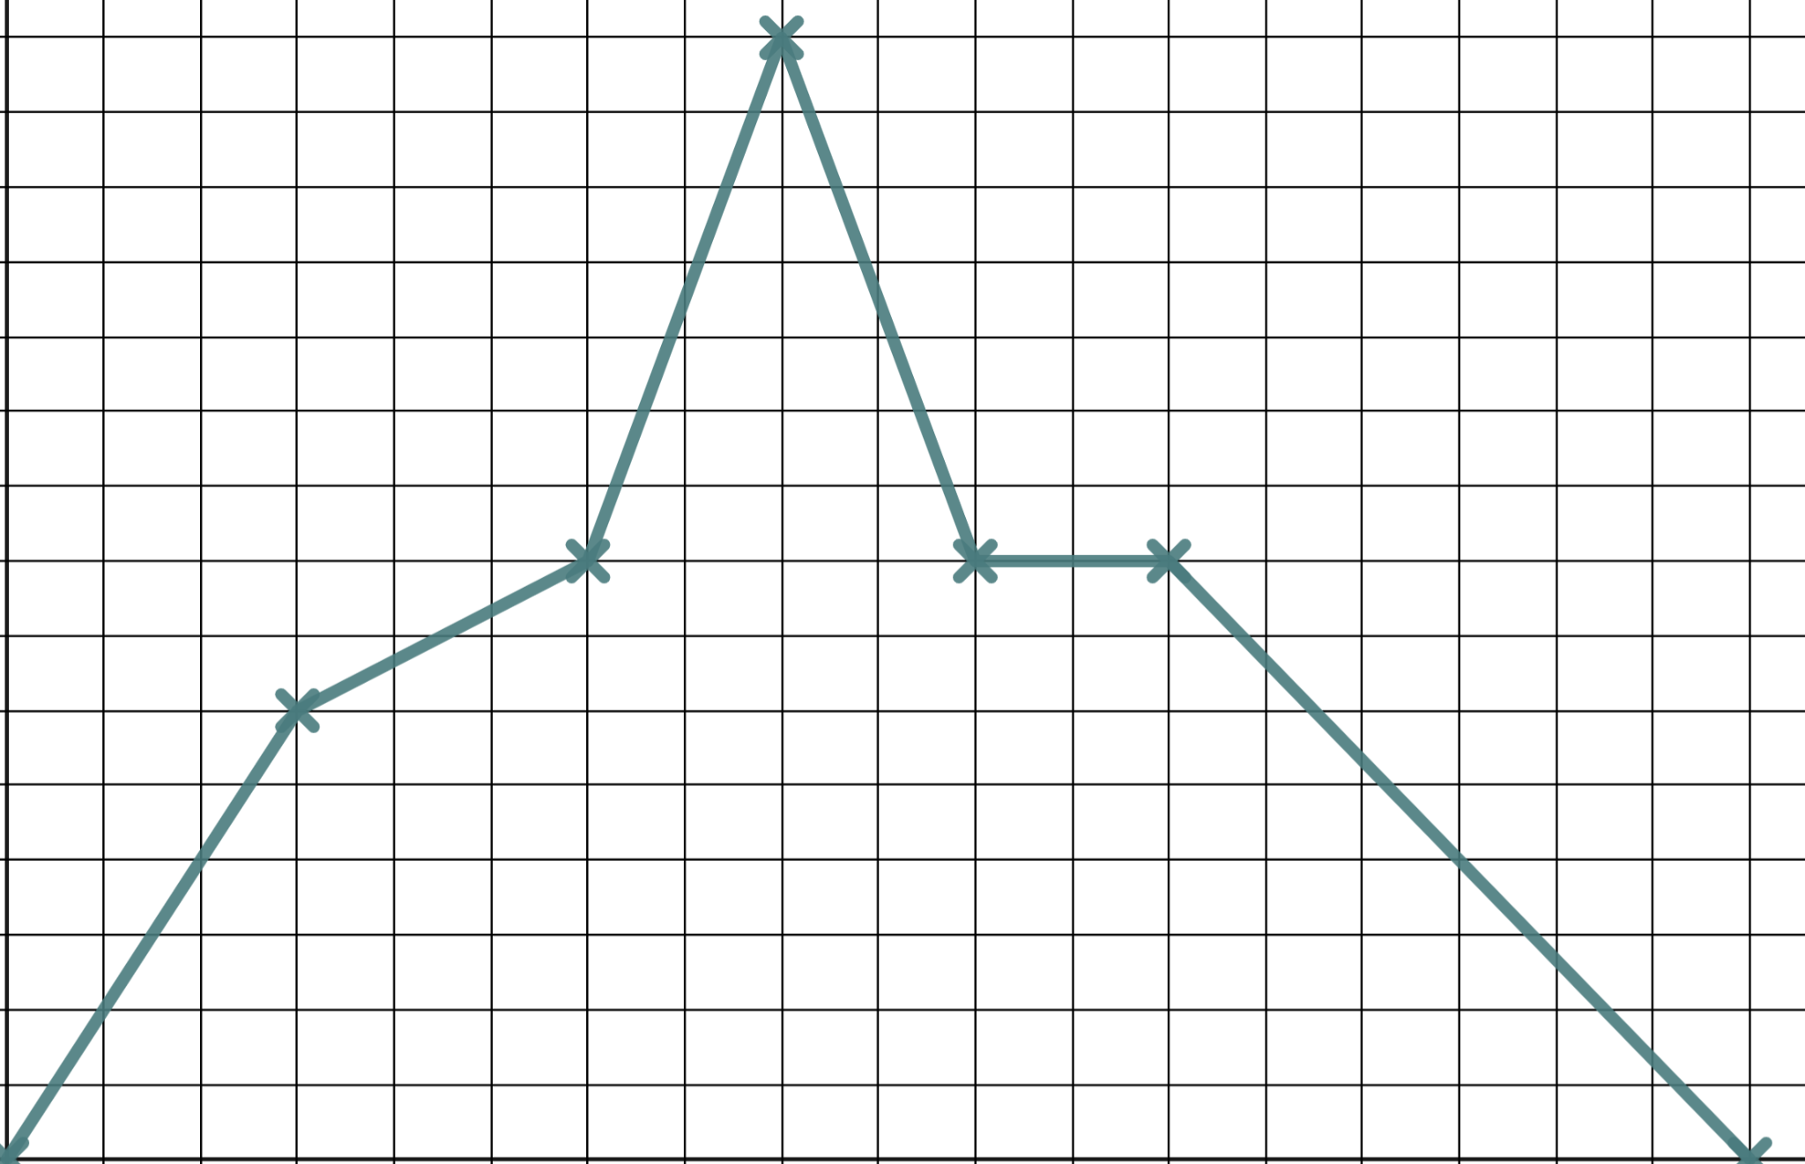
Drawing distance time graphs
1) Use the grid to plot Jacob’s long distance training ride.
“We cycle 12 km in half an hour. In the next half hour we only cycle 4 km. We speed up and cycle 14 km in 20 minutes then turn for home cycling 14 km in 20 minutes again. We rest for 20 minutes before taking an hour to cycle home after our rest.”
d
30
20
10
t
0
30
60
90
120
150
180

Slide 40
Drawing distance time graphs
2) Sketch the graph of Izzy’s car journey to visit relatives.
We set off and it takes us half an hour to do 40 km and get to the motorway. In one hour on the motorway we travel 100 km. Then we hit traffic and stop still for half an hour. Then we move slowly doing the final 20 km in an hour.
d
t

Slide 41
Drawing distance time graphs
1) Use the grid to plot Jacob’s long distance training ride.
“We cycle 12 km in half an hour. In the next half hour we only cycle 4 km. We speed up and cycle 14 km in 20 minutes then turn for home cycling 14 km in 20 minutes again. We rest for 20 minutes before taking an hour to cycle home after our rest.”
d
30
20
10
t
0
30
60
90
120
150
180

Slide 42
Drawing distance time graphs
2) Sketch the graph of Izzy’s car journey to visit relatives.
We set off and it takes us half an hour to do 40 km and get to the motorway. In one hour on the motorway we travel 100 km. Then we hit traffic and stop still for half an hour. Then we move slowly doing the final 20 km in an hour.
d
(180, 160)
160
✖
(90, 140)
✖
✖
(120, 140)
✖
(30, 40)
t
180

Slide 43
Modelling with graphs
We can model real life situations graphically, an example being a distance time graph.
d
✖
✖
Horizontal lines on distance time graphs represent moments where there is no change in distance.
Vertical lines are not possible as this would represent a change in distance in zero time.
✖
✖
t

Slide 44

© Oak National Academy 2024.
Produced in partnership with Mathematics in Education and Industry.
Licensed on the Open Government Licence v3.0, except where otherwise stated. See Oak terms and conditions.

